Slide 1

RESTful API
Andrew Beatty
Andrew.Beatty@gmit.ie
Data Representation

Slide 2

API
Application
Programming
Interface
I.e. An interface that a program that you write can use to transfer data to another program

Slide 3
SOAP
<?xml version="1.0"?> <soap:Envelope xmlns:soap="http://www.w3.org/2003/05/soap-envelope/" soap:encodingStyle="http://www.w3.org/2003/05/soap-encoding"> <soap:Body> <m:GetPrice xmlns:m="https://www.w3schools.com/prices"> <m:Item>Apples</m:Item> </m:GetPrice> </soap:Body> </soap:Envelope>

Slide 4
RESTful
REST stands for Representational State Transfer.
REST is an architecture describing how we might use HTTP.
RESTful APIs make use of more HTTP methods than just GET and POST.
Most HTTP APIs are not RESTful.
RESTful APIs adhere to a few loosely defined constraints.
Two of those constraints are that the API is stateless and cacheable.
Idempotency
More at
https://www.restapitutorial.com/

Slide 5
REST Example
Method | URL | Description | Sample return
GET | /emails | Get all the Emails | [ {id:32,from:”joe@joe.ie”,message:”hi”}, {id:33,from:”me@gmail.ie”,message:”i”}, {id:35,from:”a@b.com”,message:”blah”} ]
POST | /emails | Create an Email | {created:true}
GET | /emails/32 | Retrieve the Email with id 32 | {id:32,from:”joe@joe.ie”,message:”hi”}
PUT | /emails/32 | Update the Email with id 32 | {id:32,from:”joe@joe.ie”,message:”bye”}
DELETE | /emails/32 | Delete the Email with id 32 | {deleted:true}

Slide 6
Another Rest Example
Method | URL | Description | Sample return
GET | /email | Get all the Emails | [ {id:32,from:”joe@joe.ie”,message:”hi”}, {id:33,from:”me@gmail.ie”,message:”i”}, {id:35,from:”a@b.com”,message:”blah”} ]
POST | /email/create | Create an Email | {id:33,from:”me@gmail.ie”,message:”i”}
GET | /email/32 | Retrieve the Email with id 32 | {id:32,from:”joe@joe.ie”,message:”hi”}
PUT | /email/update/32 | Update the Email with id 32 | {id:32,from:”joe@joe.ie”,message:”bye”}
DELETE | /email/delete/32 | Delete the Email with id 32 | {success:true}

Slide 7
Stateless
Statelessness is a REST constraint.
HTTP uses the client-server model.
The server should treat each request as a single, independent transaction.
No client state should be stored on the server.
Each request must contain all of the information to perform the request.

Slide 8
Cachable
REST APIs should provide responses that are cacheable.
Intermediaries between the client and server should be able to cache responses.
This should be transparent to the client.
Cacheability increases response time.
Browsers usually cache resources, in case they are requested again.
There is usually a time limit on cached resources.

Slide 9
Site that use RESTful APIs
Facebook, google, stripe, CSO etc
More at
https://any-api.com/
Python has a lot of packages that handle these APIs (more on week06)

Slide 10
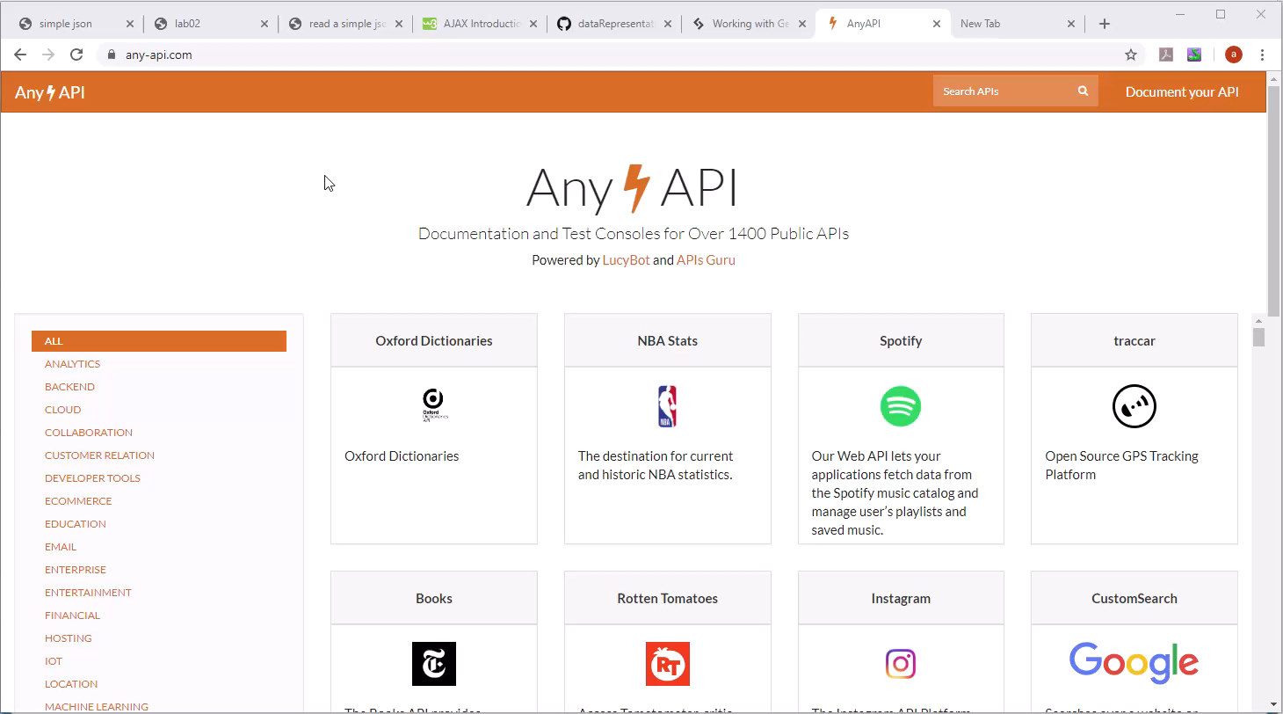

Slide 11
Summary
REST is a loose set of constraints/guidelines used for making an API
Stateless
Cacheable
Use HTTP methods
I will be going through this in more detail next week
We will create a web page that consumes a RESTful API I have created already for a database (CRUD)

